Slide 1

TEAM Wreck-it
DEBOSREE ROY
XLRI JAMSHEDPUR
DRISHA PAUL
DYUWAN SHUKLA

Slide 2
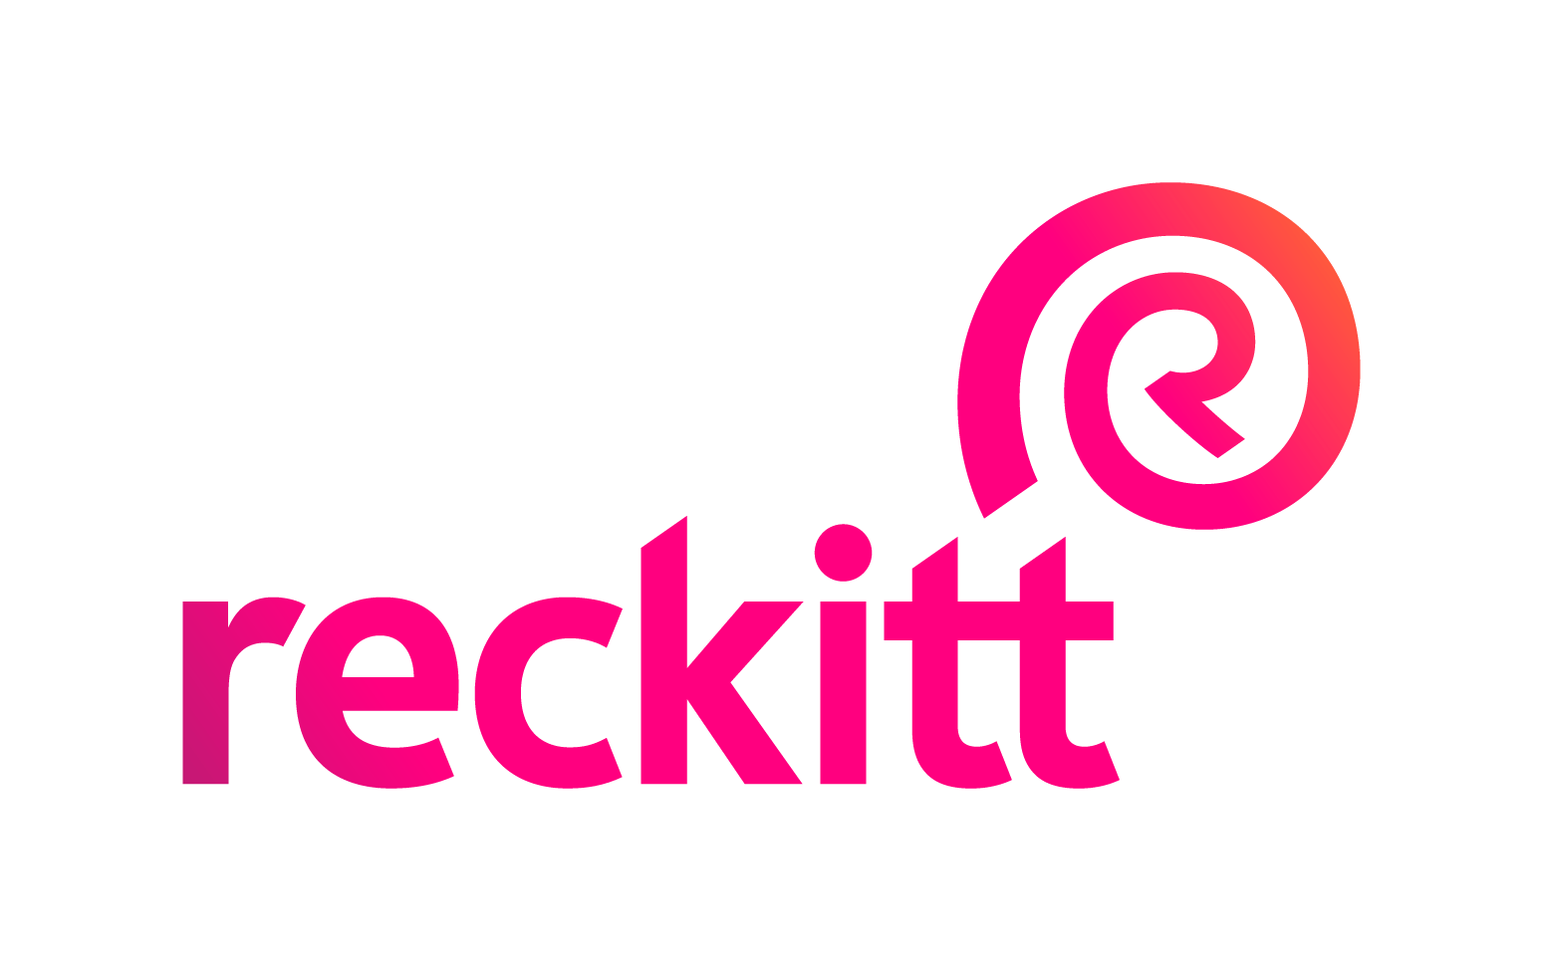
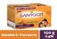
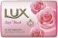
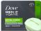
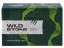
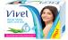
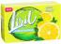
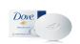
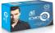
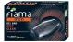

Problem & social impact
Consumer insights
4P s of New product
Existing product innovation
Financials
Dettol skincare and Neem are our biggest interventions, without cannibalising the others. Need to differentiate brands under Dettol
A
New product innovation
Our proposal : A soap that breaks all gender norms….
B
Existing product innovation
The bar soap market : The market for bar soap still remains the largest…
75.5% of the households used bar soap for bathing in previous 30 days
Penetration of bar soap in rural India is around 50%
900 million children don’t have access to soap in schools
90%
Indians still use bar soap for bathing as compared 9% who use body shower gel
BRAND | PENETRATION
Dettol | 20%
Lux | 15%
Santoor | 13%
Vivel | 12%
Lifebuoy | 10%
SKU | % PURCHASED
35gm | 52%
75gm | 25%
100gm | 15%
>=125gm | 8%
6.2%
CAGR of 6.2% with expected market size to be 4,139 US million dollars
Category growth
Beauty and skincare are associated with feminine attributes, softer colours and with
Soap bars for men are associated with a dark colour, words like , ‘cool’, ‘fresh’,
For the consumer who doesn’t associate with the binary, there is a sense of feeling left out
Neem | 8%
Beauty & skincare | 7%
Germ-protection | 6.5%
Freshness | 6%
Cool | 5%
The clear distinction between genders must be broken
Rural India is more comfortable in buying smaller packs
Problem statement 1
Problem statement 2
There is need for a family soap that breaks gender stereotypes and can be used by one and all
Penetrate the rural markets of India and provide maximum germ protection with the trust of Dettol through affordable SKUs
Beauty and skincare and neem have higher category growth
What consumers look for in bar soap for skincare – results of our survey
Other than fragrance, there is no major difference in the soap between men and women
Plan of action
53%
Fragrance / any kind of essence
“My daughter is 14. I don’t know which soap to buy for her, something that won’t harm her skin” …..Rashmi,39
Current performance
potential
To-do
65%
Wants to see lather and cleaning effect
Original
no intervention
72%
Want to see moisturising effect
“there is no soap I feel represents me. don’t want a female or male soap bar”...Priyam from LQBTQIA+ community
Skincare
change positioning
What consumers associate with Dettol
Lime
expand
Trusted for germ protection
Not in top 5 choices in terms of skincare
Aloe
expand

Slide 3
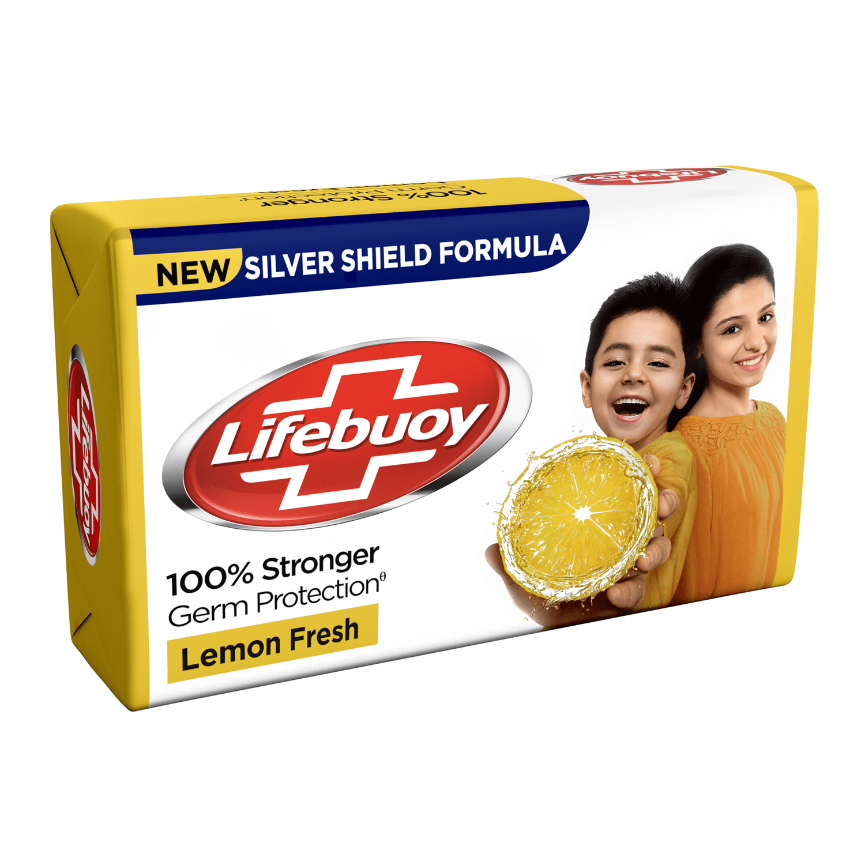
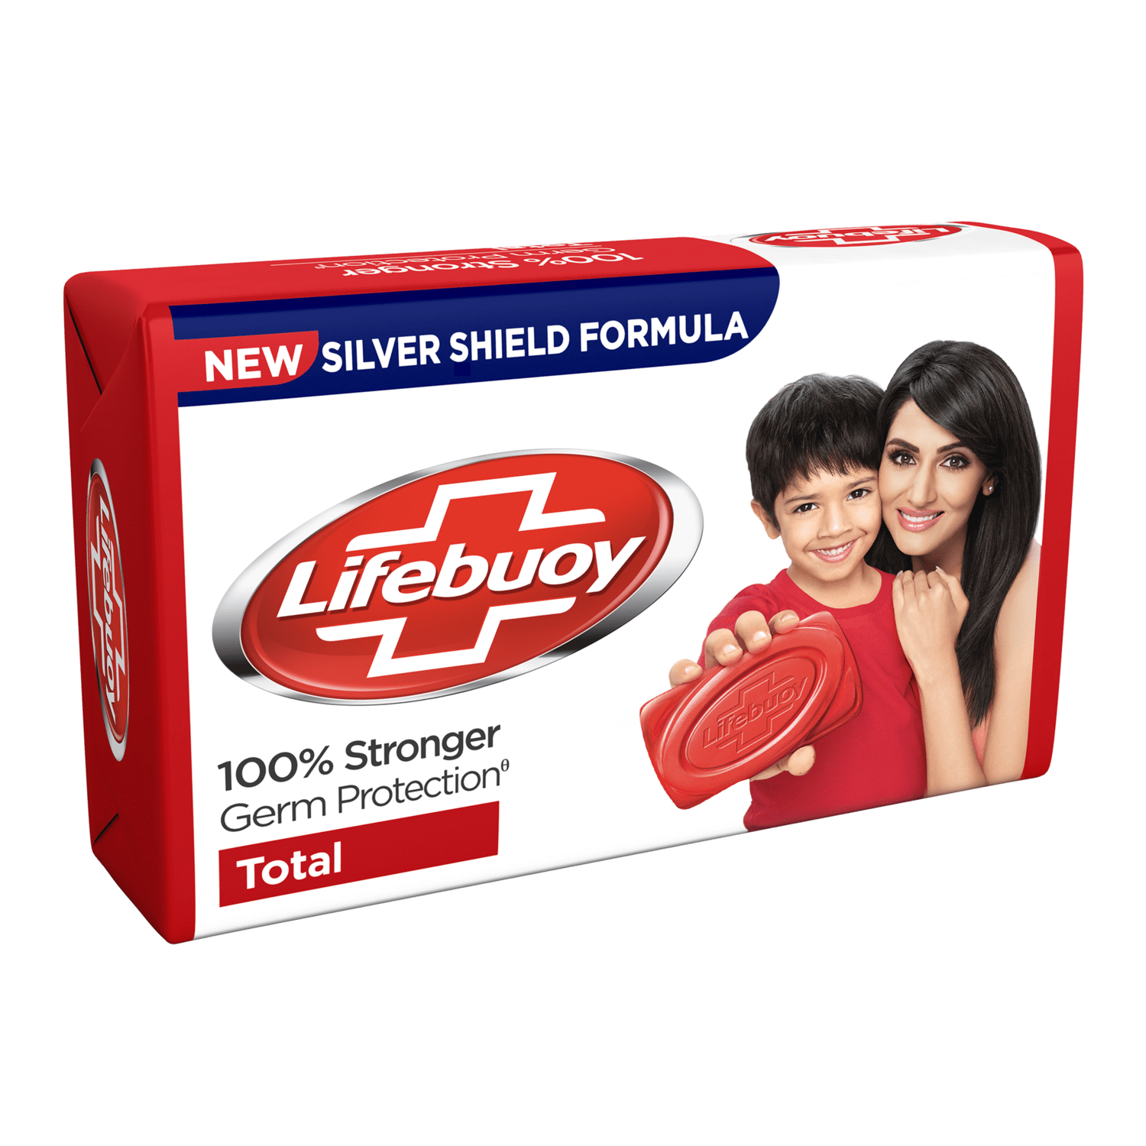
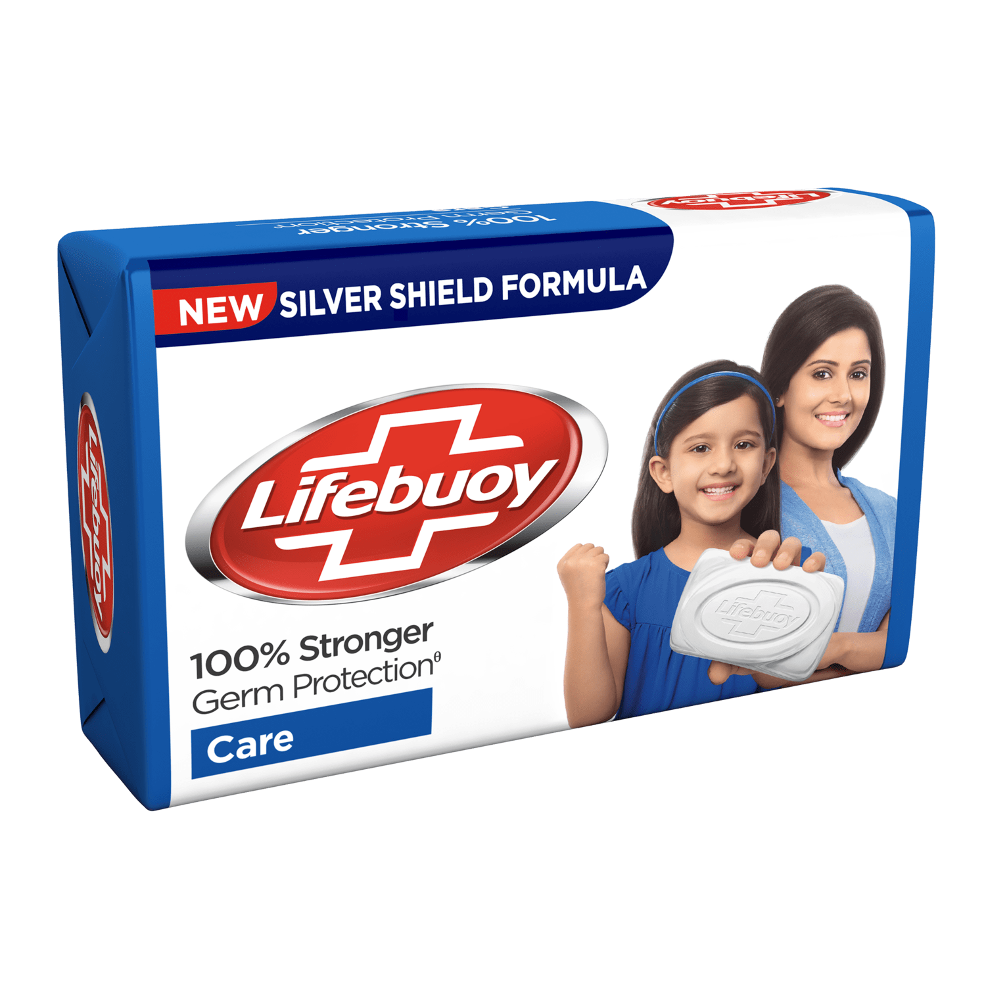
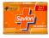
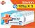

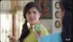



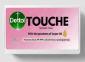
Problem & social impact
Consumer insights
4P s of New product
Existing product innovation
Financials
We propose a separate brand under Dettol which shall a gender neutral soap, can be used by all
Skincare soap bar market
Target consumer primarily women
Consumer uses premium products for face, and a basic product for the skin
Soap | Tagline | Promise & Core Offering | Target Consumer Group
 | Real Beauty Deserves Real Care | Nourishment, soft smooth skin | Men and women of all ages
 | Khoobsoorati bas main, duniya muthi main | Skin hydration and rejuvenation | Men and women
 | Beautiful today, tomorrow | Luxury bathing experience | Youth and young adults
 | Pure & Gentle | Pure and gentle cleansing, | Individuals with sensitive skin
 | Young soap | Cleansing, nourishing, revitalizing | Adults, primarily women
None of them talk about skin protection
Brand associated with the colour
Competitors positioning
Positions towards kids
Advertisement analysis
Positions towards kids, low price SKU
Low priced SKUs, high rural penetration
Dettol skincare
Other variants
Using celebrity endorsement didn’t resonate with Dettol’s “family soap” image. Promises too many things
Connecting Aloe Vera, which people usually associate with moisturising, to skin protection
No difference across brands. Germ protection dominates
Our proposal - Dettol TOUCHE
Only talked about anti-bacterial property of Dettol with no emphasis on skincare
Releasing advertisements in very specific regional languages, creating a communication barrier in other zones
Dettol TOUCHE is our proposal for the new product – a gender neutral soap for the entire family
All the Dettol brands talk the same thing, no unique proposition. Hence, there is no extra added value in buying a different brand
Proposed pricing for 125 gm Dettol TOUCHE
Ideal Price: Rs 70-80
Dettol TOUCHE is a soap bar that breaks the gender driven beauty standards. It promises the care and trust of the brand
Competitor pricing in appendix
For male consumers, cleanliness & freshness are the most important
Dettol TOUCHE isn’t a beauty soap. It doesn’t promise a lot. It does what a bathing soap is supposed to do

Slide 4




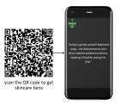




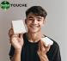

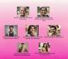

Dettol TOUCHE is a soap for all, marketed through most accessible channels in a phased manner through different cities
Problem & social impact
Consumer insights
4P s of New product
Existing product innovation
Financials
Distribution
Channels
New consumer journey
The storyline of a TV advertisement showing how Dettol is a soap for your family
Dettol TOUCHE: sab ke liye
Start with mega, metros of South and west
Use Dettol TOUCHE to increase D2C presence through online marketplaces
Greater focus on supermarkets like Spencers
Attracting new consumer
According to case facts, the skincare variant has highest penetration in West(34.35%) followed by South(25.44%)
Mystery QR to generate awareness
Kiosks at malls to give instant skin report
Visual merchandising
Skincare for the young
Increase till tier 1 and tier 2 cities
A teenage girl, going through puberty comes home after her sports practice & her mother hands her Dettol TOUCHE
Go below tier 2
Go below tier 2
Converting them
Product placement
Free product trials
Personalized content
Targeted content towards separate
Protection from harmful germs
Breaking the germ protection image
A 26-year-old boy comes home covered in dirt. Concerned about germs, he goes to take a bath with Dettol TOUCHE
Mystery QR
The Derma section
Big size banners with these QRs only
Gives a pop-up skincare fact upon scanning
Include Dermatologists’ opinion on skincare & germ protection, and how Dettol TOUCHE can help in newspapers, advertisements
Retaining them
Customer reviews in online portals
Partnerships, social media marketing
Influencer marketing
The soap everyone uses
The mother of 2 opening a new pack of Dettol TOUCHE, portraying the daily use of the soap in their house
The big idea : Beauty for all with the trust of Dettol TOUCHE
Dettol TOUCHE: sab ke liye
"My Beautiful Truth" campaign
Partnership with LQBTQ+ Comm
The soap everyone uses
An office goer 50-year-old returns home tired & sweaty & heads directly to the shower with the Dettol TOUCHE soap
Encourage LGBTQ+ members to share their "Beautiful Truth" stories on social media.
The most inspiring stories can be featured in ad campaigns, and the storytellers could be offered product ambassadorships
Invite designing ideas from the LGBTQIA+ community, the best of which will be featured on the packaging of the soapns
Family tree infographic
Each branch represents a different generation of the family & their different skincare needs, & how Dettol TOUCHE caters to each of them
Invite designing ideas from the LGBTQIA+ community, the best of which will be featured on the packaging of the soapns
Trust of ages
The eldest family member asks for a soap to take a bath with. When given a soap bar, he refuses & asks for Dettol because he trusts the brand
Partnership with beauty influencers
Through YT, insta

Slide 5
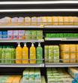

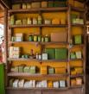




Problem & social impact
Consumer insights
4P s of New product
Existing product innovation
Financials
The existing variants have to penetrate the younger consumers & rural market through offline & online channels
The big idea : increase reach and penetration of Dettol Neem
Purchase & Distribution Channels
Current situation- The Dettol neem brand doesn’t resonate with the youth
Display at local kiranas and supermarkets
Survey results
Survey results
Consumer insight: “Usually whenever I go to buy soaps, I have a brand in my mind. But whenever I don’t, I go with whatever I see on the shop selves, or if I can find the right SKU which will fill it in my budget”
35% consumers not aware of the Dettol Neem brand
75% cannot recall having seen any Dettol Neem advertisement
Herbal/ ayurveda
Only 37% households in rural India are aware of the Dettol Neem soap
Only 35% youngsters in India use the Dettol Neem variant
Why: Increase recall value of the variants and tap the rural Indian markets, while increasing visibility in the urban markets
What: create more awareness about the new release and existence of different variants
TV and social media advertisements
Why: Broadening the target consumer of the Neem variant to include the young adults
How:
Urban market: Display the new smaller SKUs in shelves closest to eye level
Rural market: Offer customers the newer SKUs when asked for a soap to aware them about the release & variant
What: Frequent adverts showing the Neem soap being a preferred products for the adults
How:
Dettol, Harjagah Harwaqt: A group of young adults are trekking in a forest. They take a bath in a nearby waterbody and worry about the germs and bacteria in their surroundings. One of them pulls out a bar of Dettol Neem soap, saying it will kill 99.99% of germs and protect their skin from infection. They continue their trek with confidence, knowing they are protected from the germs and bacteria in their surroundings.
Availability on website and e-commerce
Consumer insight: “I usually do not take a hassle of visiting the local shop for small essentials- I usually order online, whichever trustworthy brand I see first through instant delivery”
Introducing smaller SKUs
Why: Make the variants more affordable & penetrate the rural markets
Why: Enhance the recognition of the lesser purchased variants
What: Releasing smaller SKUs & displaying them in local kirana shops; frequent TV adverts in multiple regional languages
What: Creates easy explore and purchase points for consumers
How: #Suraksha, budget me: A housewife enters a rural Indian kirana shop to buy her monthly groceries. She asks the shopkeeper for a Dettol soap, but is disappointed to find out that she is short on cash. As she is about to leave, the shopkeeper calls her back and hands her a 35gm Dettol Neem soap, telling her that she can now have the protection and trust of Dettol within budget.
How:
Make all the variants present in the market, visible on the website along with the SKUs, available for purchase
More presence on e-commerce websites like Amazon, BigBasket, Instamart and other online groceries and platforms to provide quick and easy delivery

Slide 6
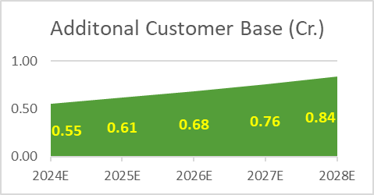
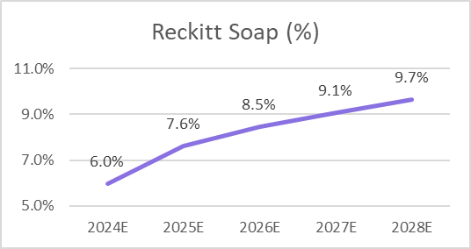
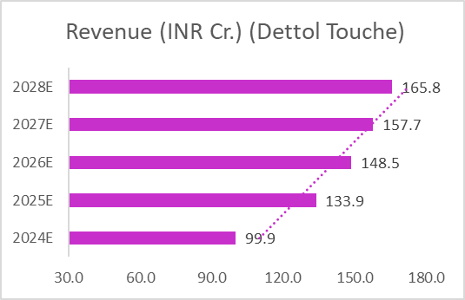
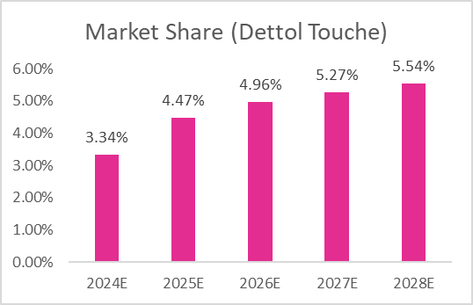

Financials: Upto 10% additional Revenue for Reckitt in Bar Soap Category
Problem & social impact
Consumer insights
4P s of New product
Existing product innovation
Financials
Profit (Dettol Touche)
Projections (Dettol Neem-35g)
Profit (Dettol Neem-35g)
Cost Breakdown: Marketing
Note
All expenses increased by 5% annually | Marketing Spend grown by 10% YoY
Staff and R&D costs as proportion of Revenue to costs from Annual Report ’22
All numbers in INR Cr. | Additional Explanation & Detail in Excel Sheet Attached
Combined Impact (Touche + Neem)
27.5%
Net margin Dettol Touche
14.4%
Excel
Net margin Neem (35g)
₹ 222 Cr
Attached Sheet includes sources and assumptions and applied in the model

Slide 7
APPENDIX

Slide 8

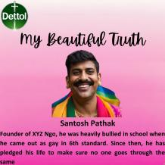

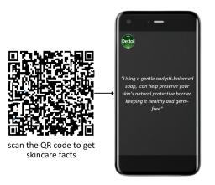
Dettol TOUCHE- sab ke liye: All family members trying the sop for a week and sharing their before-after experience
My Beautiful Truth: Members of the LGBTQIA+ community share their stories
Family tree infographic: Lists down the skincare needs and expectations of different generations
Mystery QR:
Gives a pop-up skincare fact upon scanning
65%
Willing to pay a premium for an improved Beauty Soap

Slide 9
Ideal Price: Rs 70-80
65%
Willing to pay a premium for an improved Beauty Soap

